Slide 1
Acknowledgments
S. Athuraliya, D. Lapsley, V. Li, Q. Yin (UMelb)
J. Doyle (Caltech), K.B. Kim (SNU/Caltech), F. Paganini (UCLA), J. Wang (Caltech), Z. Wang (UCLA)
L. Peterson, L. Wang (Princeton)
Matthew Roughan (AT&T Labs)

Slide 2
TCP Congestion Control:
Algorithms & Models
Steven Low
netlab.caltech.edu
IPAM, 2002
Copyright, 1996 © Dale Carnegie & Associates, In
Notes:
IEEE ICC 2000 (half day), Louisiana (June 2000), Cisco (Nov 2000),
Grampians Workshop (half day), Australia (Dec 2000)
IEEE Infocom 2001 (full day, with Matthew Roughan), Anchorage, Alaska (April 2001)
ACM Sigmetric 2001 (half day), Cambridge MA (June 2001)
ACM Sigcomm 2001 (half day), San Diego CA (August 2001)
IPAM (Institute for Pure and Applied Mathematics), UCLA (March 2002)

Slide 3
Outline
Introduction
Algorithms
  Window flow control
  TCP algorithm: Tahoe, Reno, Vegas
  AQM algorithm: RED, REM, variants
Models
  Duality model
  Linear dynamic model

Slide 4
Part 0
Introduction

Slide 5
TCP/IP Protocol Stack
Applications (e.g. Telnet, HTTP)
TCP
UDP
ICMP
IP
ARP
Link Layer (e.g. Ethernet, ATM)
Physical Layer (e.g. Ethernet, SONET)

Slide 6
Packet Terminology
Application Message
MSS
TCP Segment
TCP hdr
TCP data
IP Packet
20 bytes
IP hdr
IP data
Ethernet Frame
20 bytes
Ethernet
Ethernet data
14 bytes
MTU 1500 bytes
4 bytes

Slide 7
IP
Packet switched
Datagram service
  Unreliable (best effort)
  Simple, robust
Heterogeneous
Dumb network, intelligent terminals
  Compare with PSTN

Slide 8
TCP
Packet switched
End-to-end
  Reliable, in order delivery of a packet stream
  Reliability through ACKs
Flow control: use bandwidth efficiently

Slide 9
Success of IP
Simple/Robust
Robustness against failure
Robustness against technological evolutions
WWW, Email, Napster, FTP, …
Applications
IP
Transmission
Ethernet, ATM, POS, WDM, …

Slide 10
IETF
Internet Engineering Task Force
  Standards organisation for Internet
  Publishes RFCs - Requests For Comment
    standards track: proposed, draft, Internet
    non-standards track: experimental, informational
    best current practice
    poetry/humour (RFC 1149: Standard for the transmission of IP datagrams on avian carriers)
  TCP should obey RFC
    no means of enforcement
    some versions have not followed RFC
http://www.ietf.org/index.html

Slide 11
RFCs of note
RFC 791: Internet Protocol
RFC 793: Transmission Control Protocol
RFC 1180: A TCP/IP Tutorial
RFC 2581: TCP Congestion Control
RFC 2525: Known TCP Implementation Problems
RFC 1323: TCP Extensions for High Performance
RFC 2026: Internet standards process

Slide 12
TCP versions
TCP is not perfectly homogenous (200+)
4.2 BSD first widely available release of TCP/IP (1983)
Windows 95
4.3 BSD (1986)
Windows NT
4.3 BSD Tahoe (1988)
SunOS 4.1.3,4.1.4
4.3 BSD Reno (1990)
Solaris 2.3,2.4
IRIX
Linux 1.0
Digital OSF
HP/UX
4.4 BSD (1993)
Vegas (1994)
NewReno (1999)
.....
Notes:
[source: G.R.Wright and W.R.Stevens, TCP/IP Illustrated, Vol 2; J. Hoe, MSc Thesis, pp.22]
Tahoe (1988): slow start, congestion avoidance, fast retransmit
Reno (1990): fast recovery, TCP header prediction, SLIP header compression, routing table changes
4.4BSD (1993): multicasting, long fat pipe modifications

Slide 13
Simulation
ns-2: http://www.isi.edu/nsnam/ns/index.html
  Wide variety of protocols
  Widely used/tested
SSFNET: http://www.ssfnet.org/homePage.html
  Scalable to very large networks
Care should be taken in simulations!
  Multiple independent simulations
    confidence intervals
    transient analysis – make sure simulations are long enough
  Wide parameter ranges
All simulations involve approximation

Slide 14
Other Tools
tcpdump
  Get packet headers from real network traffic
tcpanaly (V.Paxson, 1997)
  Analysis of TCP sessions from tcpdump
traceroute
  Find routing of packets
RFC 2398
http://www.caida.org/tools/

Slide 15
Part I
Algorithms

Slide 16
TCP & AQM
p_{l}(t)
x_{i}(t)
Example congestion measure p_{l}(t)
  Loss (Reno)
  Queueing delay (Vegas)

Slide 17
TCP & AQM
p_{l}(t)
AQM:
DropTail
RED
REM,PI,AVQ
x_{i}(t)
TCP:
Reno
Vegas

Slide 18
Outline
Introduction
Algorithms
  Window flow control
  TCP algorithm: Tahoe, Reno, Vegas
  AQM algorithm: RED, REM, variants
Models
  Duality model
  Linear dynamic model

Slide 19
Early TCP
Pre-1988
Go-back-N ARQ
  Detects loss from timeout
  Retransmits from lost packet onward
Receiver window flow control
  Prevent overflows at receive buffer
Flow control: self-clocking

Slide 20
Why Flow Control?
October 1986, Internet had its first congestion collapse
Link LBL to UC Berkeley
  400 yards, 3 hops, 32 Kbps
  throughput dropped to 40 bps
  factor of ~1000 drop!
1988, Van Jacobson proposed TCP flow control

Slide 21
Effect of Congestion
Packet loss
Retransmission
Reduced throughput
Congestion collapse due to
  Unnecessarily retransmitted packets
  Undelivered or unusable packets
Congestion may continue after the overload!
throughput
load

Slide 22
Window Flow Control
RTT
Source
1
2
W
1
2
W
time
data
ACKs
Destination
1
2
W
1
2
W
time
~ W packets per RTT
Lost packet detected by missing ACK

Slide 23
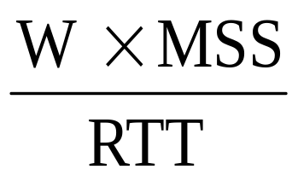
Window flow control
Limit the number of packets in the network to window W
Source rate = bps
If W too small then rate « capacity
If W too big then rate > capacity
=> congestion
Adapt W to network (and conditions)
  W = BW x RTT

Slide 24

Congestion Control
TCP seeks to
  Achieve high utilization
  Avoid congestion
  Share bandwidth
Window flow control
  Source rate = packets/sec
  Adapt W to network (and conditions)
  W = BW x RTT

Slide 25
TCP Window Flow Controls
Receiver flow control
  Avoid overloading receiver
  Set by receiver
  awnd: receiver (advertised) window
Network flow control
  Avoid overloading network
  Set by sender
  Infer available network capacity
  cwnd: congestion window
Set W = min (cwnd, awnd)

Slide 26
Receiver Flow Control
Receiver advertises awnd with each ACK
Window awnd
  closed when data is received and ack’d
  opened when data is read
Size of awnd can be the performance limit (e.g. on a LAN)
  sensible default ~16kB

Slide 27
Network Flow Control
Source calculates cwnd from indication of network congestion
Congestion indications
  Losses
  Delay
  Marks
Algorithms to calculate cwnd
  Tahoe, Reno, Vegas, RED, REM …

Slide 28
Outline
Introduction
Algorithms
  Window flow control
  TCP algorithm: Tahoe, Reno, Vegas
  AQM algorithm: RED, REM, variants
Models
  Duality model
  Linear dynamic model

Slide 29
TCP Congestion Controls
Tahoe (Jacobson 1988)
  Slow Start
  Congestion Avoidance
  Fast Retransmit
Reno (Jacobson 1990)
  Fast Recovery
Vegas (Brakmo & Peterson 1994)
  New Congestion Avoidance
RED (Floyd & Jacobson 1993)
  Probabilistic marking
REM (Athuraliya & Low 2000)
  Clear buffer, match rate

Slide 30
Variants
Tahoe & Reno
  NewReno
  SACK
  Rate-halving
  Mod.s for high performance
AQM
  RED, ARED, FRED, SRED
  BLUE, SFB
  REM, PI, AVQ

Slide 31
TCP Tahoe (Jacobson 1988)
window
time
SS
CA
SS: Slow Start
CA: Congestion Avoidance

Slide 32
Slow Start
Start with cwnd = 1 (slow start)
On each successful ACK increment cwnd
cwnd ← cnwd + 1
Exponential growth of cwnd
each RTT: cwnd ← 2 x cwnd
Enter CA when cwnd >= ssthresh

Slide 33
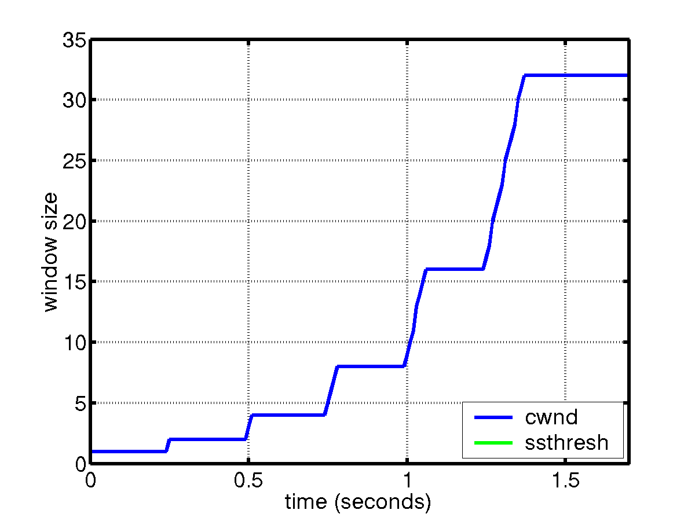
Slow Start
sender
receiver
cwnd
1
data packet
1 RTT
ACK
2
3
4
5
6
7
8
cwnd ← cwnd + 1 (for each ACK)

Slide 34
Congestion Avoidance
Starts when cwnd ≥ ssthresh
On each successful ACK: cwnd ← cwnd + 1/cwnd
Linear growth of cwnd
each RTT: cwnd ← cwnd + 1

Slide 35
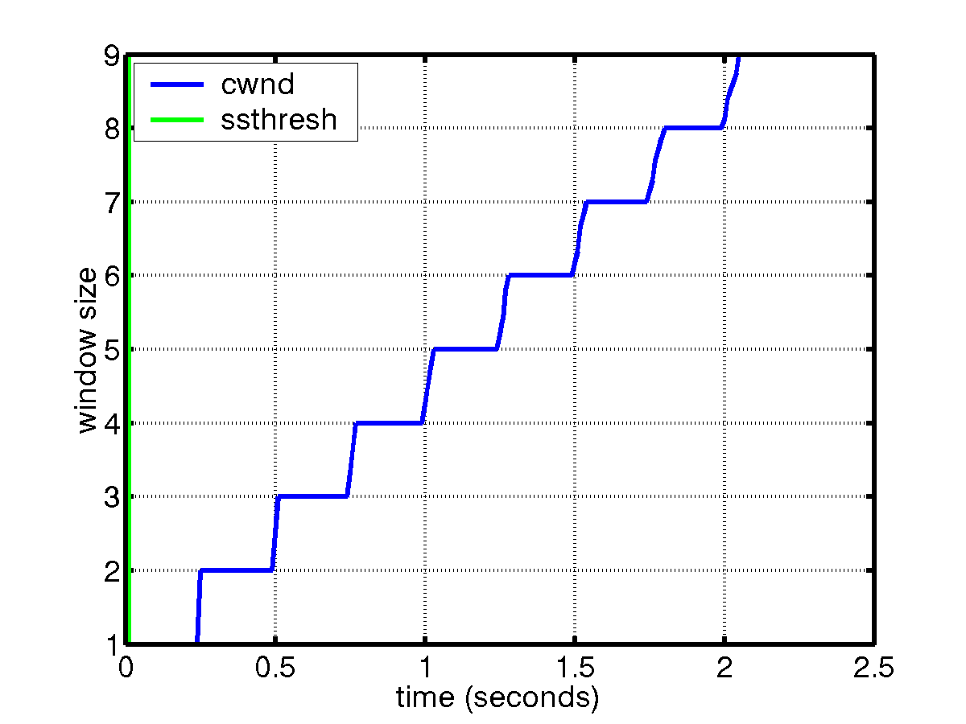
Congestion Avoidance
sender
receiver
cwnd
1
data packet
ACK
2
1 RTT
3
4
cwnd ← cwnd + 1 (for each cwnd ACKS)

Slide 36
Packet Loss
Assumption: loss indicates congestion
Packet loss detected by
  Retransmission TimeOuts (RTO timer)
  Duplicate ACKs (at least 3)
Packets
1
2
3
4
5
6
7
Acknowledgements
1
2
3
3
3
3

Slide 37
Fast Retransmit
Wait for a timeout is quite long
Immediately retransmits after 3 dupACKs without waiting for timeout
Adjusts ssthresh
flightsize = min(awnd, cwnd)
ssthresh ← max(flightsize/2, 2)
Enter Slow Start (cwnd = 1)

Slide 38
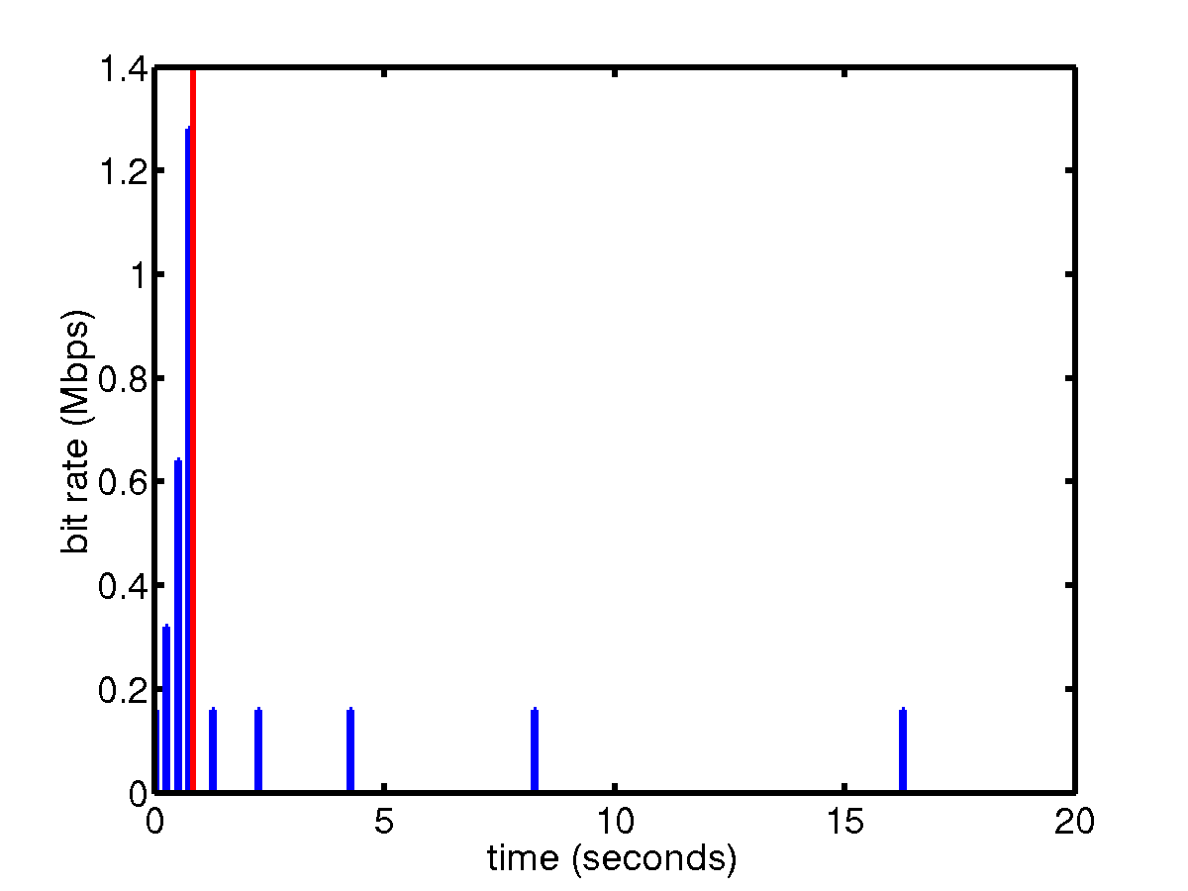
Successive Timeouts
When there is a timeout, double the RTO
Keep doing so for each lost retransmission
  Exponential back-off
  Max 64 seconds¹
  Max 12 restransmits¹
  1 - Net/3 BSD

Slide 39
Summary: Tahoe
Basic ideas
  Gently probe network for spare capacity
  Drastically reduce rate on congestion
  Windowing: self-clocking
  Other functions: round trip time estimation, error recovery
for every ACK {
if (W < ssthresh) then W++ (SS)
else W += 1/W (CA)
}
for every loss {
ssthresh = W/2
W = 1
}

Slide 40
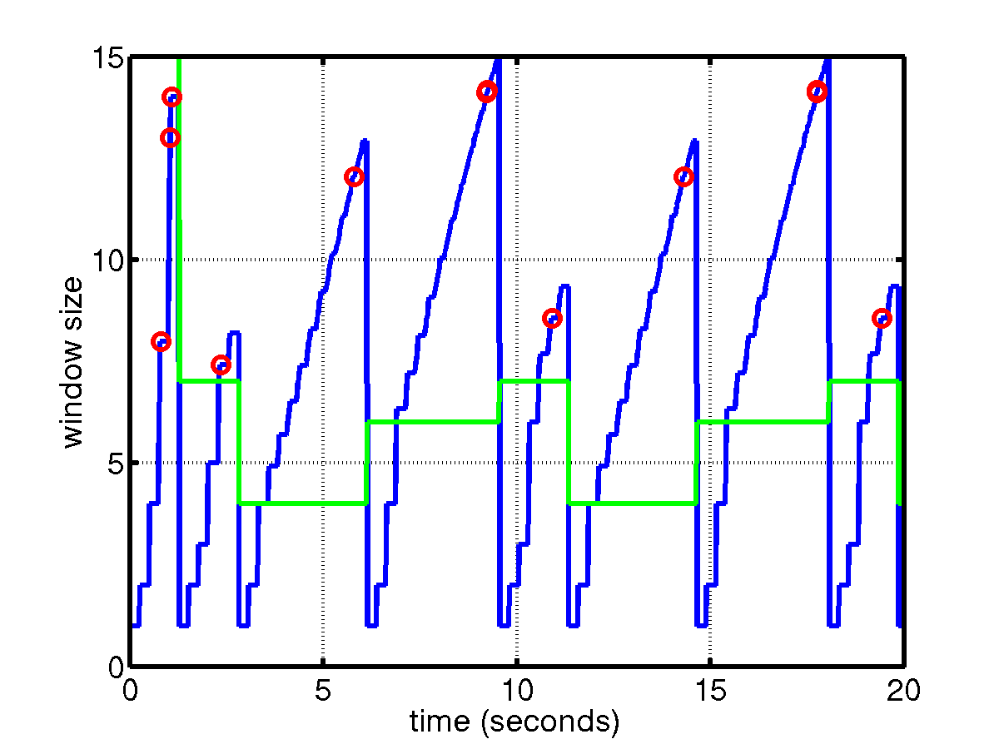
TCP Tahoe

Slide 41
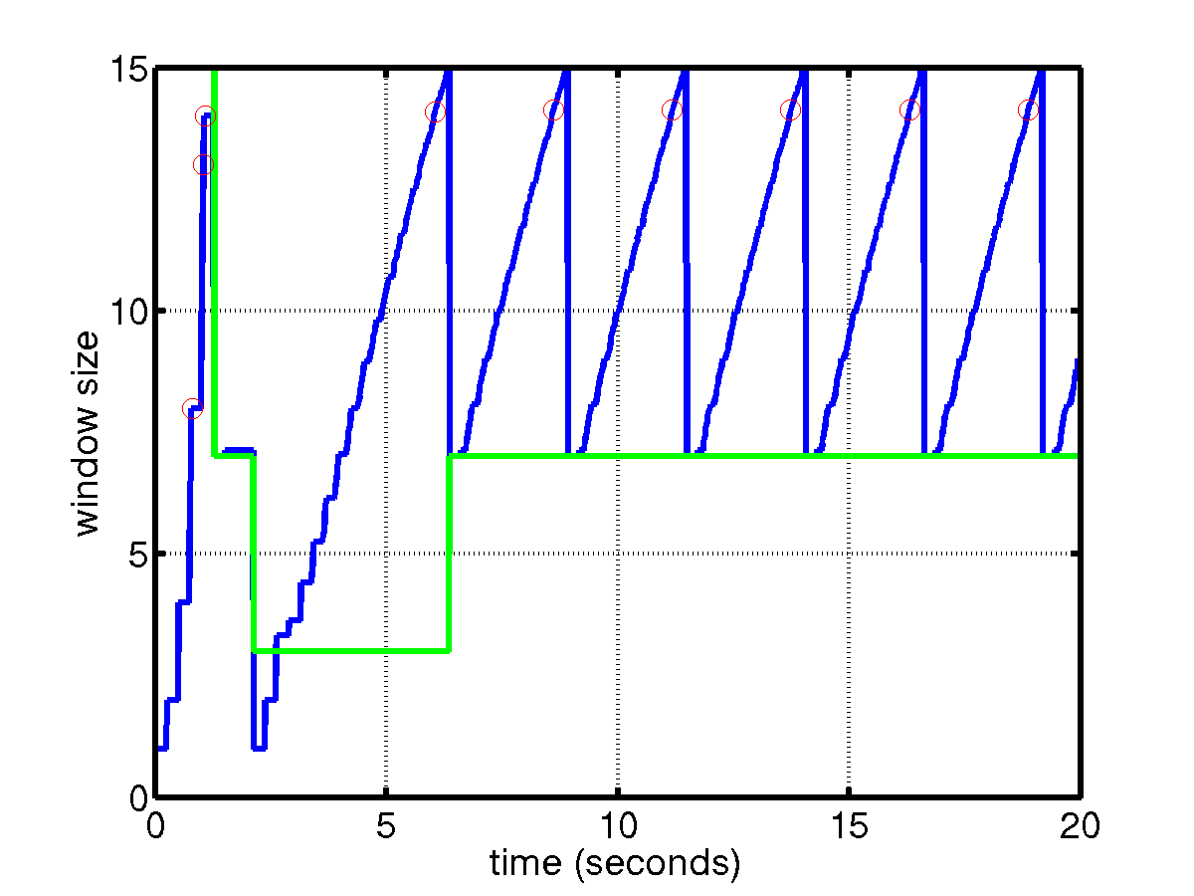
TCP Reno (Jacobson 1990)
SS
CA
Fast retransmission/fast recovery

Slide 42
Fast recovery
Motivation: prevent `pipe’ from emptying after fast retransmit
Idea: each dupACK represents a packet having left the pipe (successfully received)
Enter FR/FR after 3 dupACKs
  Set ssthresh ← max(flightsize/2, 2)
  Retransmit lost packet
  Set cwnd ← ssthresh + ndup (window inflation)
  Wait till W=min(awnd, cwnd) is large enough; transmit new packet(s)
  On non-dup ACK (1 RTT later), set cwnd ← ssthresh (window deflation)
Enter CA
Notes:
After FR/FR, when CA is entered, cwnd is half of the window when lost was detected.
So the effect of lost is halving the window.
[Source: RFC 2581, Fall & Floyd, “Simulation based Comparison of Tahoe, Reno, and SACK TCP”]

Slide 43
Example: FR/FR
S
1
2
3
4
5
6
7
8
1
9
10
11
time
Exit FR/FR
R
0
0
0
0
0
0
0
8
time
cwnd
8
7
9
11
4
ssthresh
4
4
4
4
Fast retransmit
  Retransmit on 3 dupACKs
Fast recovery
  Inflate window while repairing loss to fill pipe

Slide 44
Summary: Reno
Basic ideas
  Fast recovery avoids slow start
  dupACKs: fast retransmit + fast recovery
  Timeout: fast retransmit + slow start
dupACKs
congestion avoidance
FR/FR
timeout
slow start
retransmit

Slide 45
NewReno: Motivation
FR/FR
S
1
2
3
4
5
6
7
8
9
0
1
3
time
D
0
0
0
0
0
2
time
8
9
5
timeout
8 unack’d pkts
On 3 dupACKs, receiver has packets 2, 4, 6, 8, cwnd=8, retransmits pkt 1, enter FR/FR
Next dupACK increment cwnd to 9
After a RTT, ACK arrives for pkts 1 & 2, exit FR/FR, cwnd=5, 8 unack’ed pkts
No more ACK, sender must wait for timeout
Notes:
Example:
Cwnd = 10. Sender sends packets 1, 2, …, 10. Packets 1, 3, …, 9 are lost, packets 2, 4, …, 10 are received.
When 3 dupACK are received, receiver has (at least) received packets 2, 4, 6, 8. Sender retransmits packet 1, and waits, until dupACK due to arrival of packet 10 has been arrived, and then ACK due to retransmitted packet 1 has arrived, acknowledging packets 1 and 2.
This last ACK takes Reno out of Fast Recovery, with cwnd = 5. There are now 8 outstanding packets: 3, 4, …, 10. So sender cannot transmit any packet. Note that the sender will not receive any more dupACK since the window has been exhausted. It must wait, until timer expires for packet 3, and then retransmit and goes to slow start.

Slide 46
NewReno Fall & Floyd ‘96, (RFC 2583)
Motivation: multiple losses within a window
  Partial ACK acknowledges some but not all packets outstanding at start of FR
  Partial ACK takes Reno out of FR, deflates window
  Sender may have to wait for timeout before proceeding
Idea: partial ACK indicates lost packets
  Stays in FR/FR and retransmits immediately
  Retransmits 1 lost packet per RTT until all lost packets from that window are retransmitted
  Eliminates timeout

Slide 47
SACK Mathis, Mahdavi, Floyd, Romanow ’96 (RFC 2018, RFC 2883)
Motivation: Reno & NewReno retransmit at most 1 lost packet per RTT
  Pipe can be emptied during FR/FR with multiple losses
Idea: SACK provides better estimate of packets in pipe
  SACK TCP option describes received packets
  On 3 dupACKs: retransmits, halves window, enters FR
  Updates pipe = packets in pipe
    Increment when lost or new packets sent
    Decrement when dupACK received
  Transmits a (lost or new) packet when pipe < cwnd
  Exit FR when all packets outstanding when FR was entered are acknowledged
Notes:
[Sources: M. Mathis, J. Mahdavi, S. Floyd and A. Romanow, “TCP Selective Acknowledgement Options”, RFC 2018, Oct. 1996
K. Fall and S. Floyd, “Simulation-based comparisons of Tahoe, Reno and SACK TCP”, Computer Communication Review, July 1996 ]

Slide 48
Outline
Introduction
Algorithms
  Window flow control
  TCP algorithm: Tahoe, Reno, Vegas
  AQM algorithm: RED, REM, variants
Models
  Duality model
  Linear dynamic model

Slide 49
TCP Vegas (Brakmo & Peterson 1994)
window
time
SS
CA
Reno with a new congestion avoidance algorithm
Converges (provided buffer is large) !

Slide 50
Congestion avoidance
Each source estimates number of its own packets in pipe from RTT
Adjusts window to maintain estimate between αd and βd
for every RTT
{
if W/RTT_{min} – W/RTT < α then W ++
if W/RTT_{min} – W/RTT > β then W --
}
for every loss
W := W/2

Slide 51
Implications
Congestion measure = end-to-end queueing delay
At equilibrium
  Zero loss
  Stable window at full utilization
  Approximately weighted proportional fairness
  Nonzero queue, larger for more sources
Convergence to equilibrium
  Converges if sufficient network buffer
  Oscillates like Reno otherwise

Slide 52
Outline
Introduction
Algorithms
  Window flow control
  TCP algorithm: Tahoe, Reno, Vegas
  AQM algorithm: RED, REM, variants
Models
  Duality model
  Linear dynamic model

Slide 53
Active queue management
Idea: provide congestion information by probabilistically marking packets
Issues
  How to measure congestion?
  How to embed congestion measure?
  How to feed back congestion info?

Slide 54
RED (Floyd & Jacobson 1993)
Congestion measure: average queue length
b_{l}(t+1) = [b_{l}(t) + y_{l}(t) - c_{l}]⁺
Embedding: p-linear probability function
Feedback: dropping or ECN marking
marking
1
Avg queue

Slide 55
RED
Implementation
  Probabilistically drop packets
  Probabilistically mark packets
  Marking requires ECN bit (RFC 2481)
Performance
  Desynchronization works well
  Extremely sensitive to parameter setting
  Fail to prevent buffer overflow as #sources increases

Slide 56
Variant: ARED (Feng, Kandlur, Saha, Shin 1999)
Motivation: RED extremely sensitive to #sources
Idea: adapt max_{p} to load
  If avg. queue < min_{th}, decrease max_{p}
  If avg. queue > max_{th}, increase max_{p}
No per-flow information needed
Notes:
Feng, Kandlur, Saha and Shin, “A self-configuring RED gateway”, IEEE Infocom, pp. 1320-1328, March, 1999, New York, NY
ARED = Adaptive RED

Slide 57
Variant: FRED (Ling & Morris 1997)
Motivation: marking packets in proportion to flow rate is unfair (e.g., adaptive vs unadaptive flows)
Idea
  A flow can buffer up to min_{q} packets without being marked
  A flow that frequently buffers more than max_{q} packets gets penalized
  All flows with backlogs in between are marked according to RED
  No flow can buffer more than avgcq packets persistently
Need per-active-flow accounting
Notes:
Source: D. Lin and R. Morris, “Dynamics of RED”, ACM Sigcomm, Sept, 1997
FRED = Flow RED

Slide 58
Variant: SRED (Ott, Lakshman & Wong 1999)
Motivation: wild oscillation of queue in RED when load changes
Idea:
  Estimate number N of active flows
    An arrival packet is compared with a randomly chosen active flows
    N ~ prob(Hit)⁻¹
  cwnd~p^{-1/2} and Np^{-1/2} = Q₀ implies p = (N/Q₀)²
  Marking prob = m(q) min(1, p)
No per-flow information needed
Notes:
T. J. Ott, T. V. Lakshman, L. H. Wong, “SRED: Stabilized RED”, Infocom’99, pp. 1346-1355, March 1999, New York, NY
Heuristics:
sum of all cwnd’s, sum over all sources, should be roughly Q_0, the target buffer occupancy. This implies a random loss probability p.
m(q) is a piecewise constant probability, taking values in {0, p_max/4, p_max}, as a function of instantaneous queue length q.

Slide 59
Variant: BLUE (Feng, Kandlur, Saha, Shin 1999)
Motivation: wild oscillation of RED leads to cyclic overflow & underutilization
Algorithm
  On buffer overflow, increment marking prob
  On link idle, decrement marking prob

Slide 60
Variant: SFB
Motivation: protection against nonadaptive flows
Algorithm
  L hash functions map a packet to L bins (out of NxL )
  Marking probability associated with each bin is
    Incremented if bin occupancy exceeds threshold
    Decremented if bin occupancy is 0
  Packets marked with min {p₁, …, p_{L}}
h₁
h₂
h_{L-1}
h_{L}
nonadaptive
1
1
1
adaptive
1

Slide 61
Variant: SFB
Idea
  A nonadaptive flow drives marking prob to 1 at all L bins it is mapped to
  An adaptive flow may share some of its L bins with nonadaptive flows
  Nonadaptive flows can be identified and penalized

Slide 62
RED (Floyd & Jacobson 1993)
Congestion measure: average queue length
b_{l}(t+1) = [b_{l}(t) + y_{l}(t) - c_{l}]⁺
Embedding: p-linear probability function
Feedback: dropping or ECN marking
marking
1
Avg queue

Slide 63
REM (Athuraliya & Low 2000)
Congestion measure: price
p_{l}(t+1) = [p_{l}(t) + γ(α_{l} b_{l}(t)+ x^{l} (t) - c_{l} )]⁺
Embedding:
Feedback: dropping or ECN marking

Slide 64
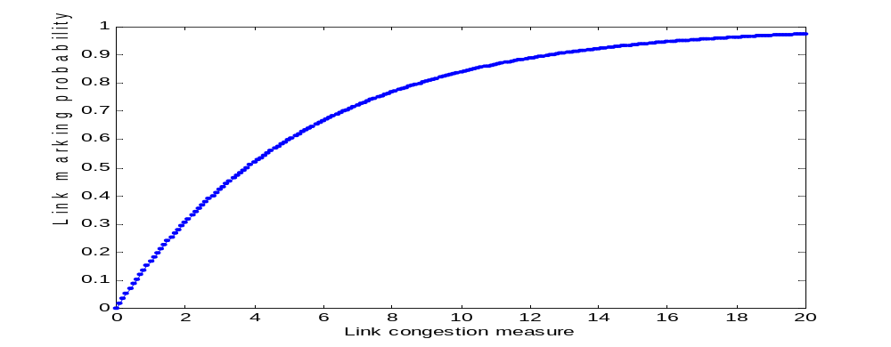
REM (Athuraliya & Low 2000)
Congestion measure: price
p_{l}(t+1) = [p_{l}(t) + γ(α_{l} b_{l}(t)+ x^{l} (t) - c_{l} )]⁺
Embedding: exponential probability function
Feedback: dropping or ECN marking

Slide 65
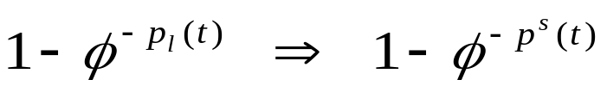
Key features
Clear buffer and match rate
Clear buffer
Match rate
Sum prices
Theorem (Paganini 2000)
Global asymptotic stability for general utility function (in the absence of delay)

Slide 66
Active Queue Management
p_{l}(t) G(p(t), x(t))
DropTail loss [1 - c_{l}/x^{l} (t)]⁺ (?)
RED queue [p_{l}(t) + x^{l}(t) - c_{l}]⁺
Vegas delay [p_{l}(t) + x^{l} (t)/c_{l} - 1]⁺
REM price [p_{l}(t) + γ(α_{l} b_{l}(t)+ x^{l} (t) - c_{l} )]⁺
x(t+1) = F( p(t), x(t) )
p(t+1) = G( p(t), x(t) )
Reno, Vegas
DropTail, RED, REM

Slide 67
Congestion & performance
p_{l}(t) G(p(t), x(t))
Reno loss [1 - c_{l}/x^{l} (t)]⁺ (?)
Reno/RED queue [p_{l}(t) + x^{l}(t) - c_{l}]⁺
Reno/REM price [p_{l}(t) + γ(α_{l} b_{l}(t)+ x^{l} (t) - c_{l} )]⁺
Vegas delay [p_{l}(t) + x^{l} (t)/c_{l} - 1]⁺
Decouple congestion & performance measure
  RED: `congestion’ = `bad performance’
  REM: `congestion’ = `demand exceeds supply’
  But performance remains good!

Slide 68
Summary
p_{l}(t)
AQM:
DropTail
RED
REM,PI,AVQ
x_{i}(t)
TCP:
Reno
Vegas

Slide 69
Application: Wireless TCP
Reno uses loss as congestion measure
In wireless, significant losses due to
  Fading
  Interference
  Handover
  Not buffer overflow (congestion)
Halving window too drastic
  Small throughput, low utilization

Slide 70
Proposed solutions
Ideas
  Hide from source noncongestion losses
  Inform source of noncongestion losses
Approaches
  Link layer error control
  Split TCP
  Snoop agent
  SACK+ELN (Explicit Loss Notification)
Notes:
Sources: Balakrishnan, Padmanabhan, Seshan and Katz, “A comparison of mechanisms for improving TCP performance over wireless links”, ToN, 5(6):756-769, Dec 1997

Slide 71
Third approach
Problem
  Reno uses loss as congestion measure
  Two types of losses
    Congestion loss: retransmit + reduce window
    Noncongestion loss: retransmit
  Previous approaches
    Hide noncongestion losses
    Indicate noncongestion losses
  Our approach
    Eliminates congestion losses (buffer overflows)

Slide 72
Third approach
Router
  REM capable
Host
  Do not use loss as congestion measure
Vegas
REM
Idea
  REM clears buffer
  Only noncongestion losses
  Retransmits lost packets without reducing window

Slide 73
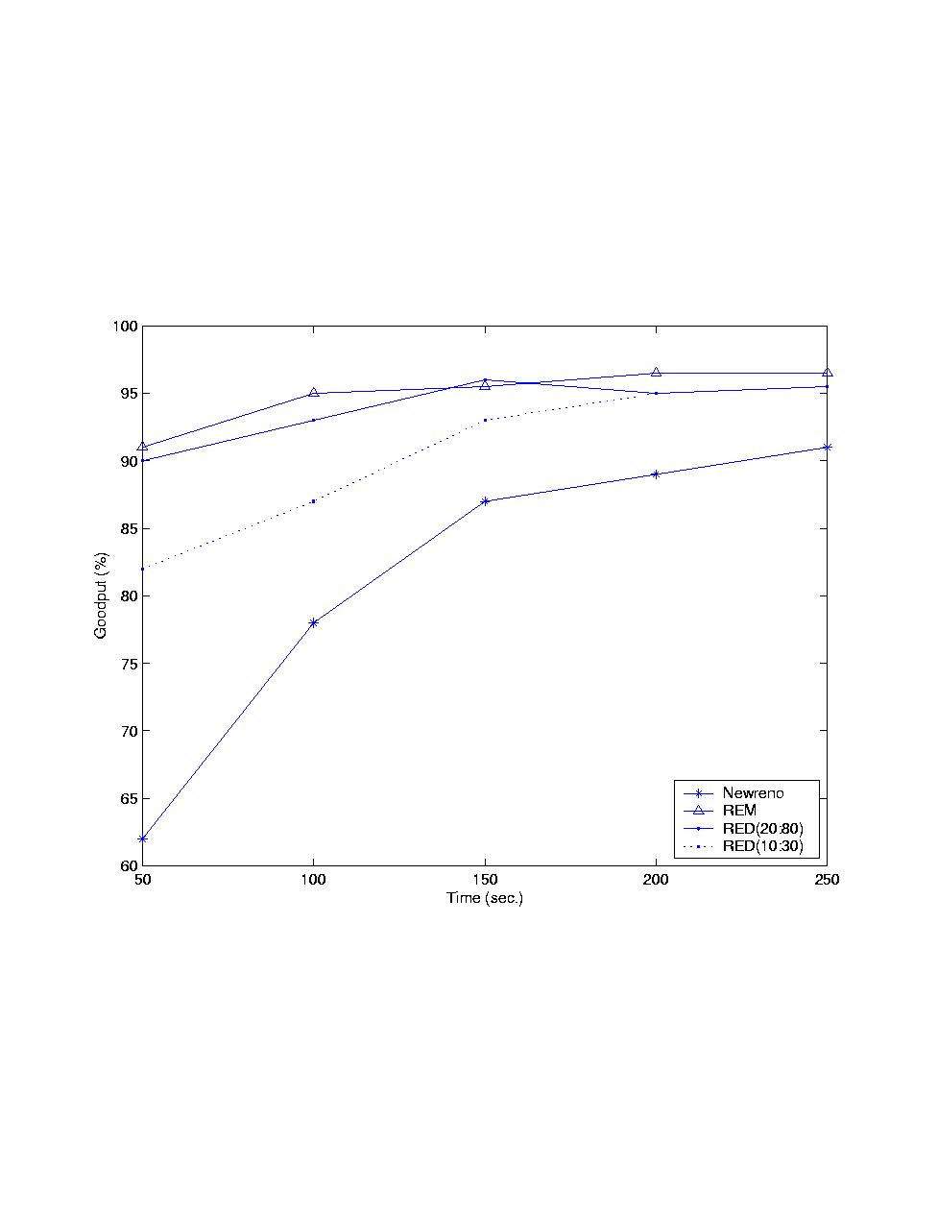

Performance
Goodput

Slide 74
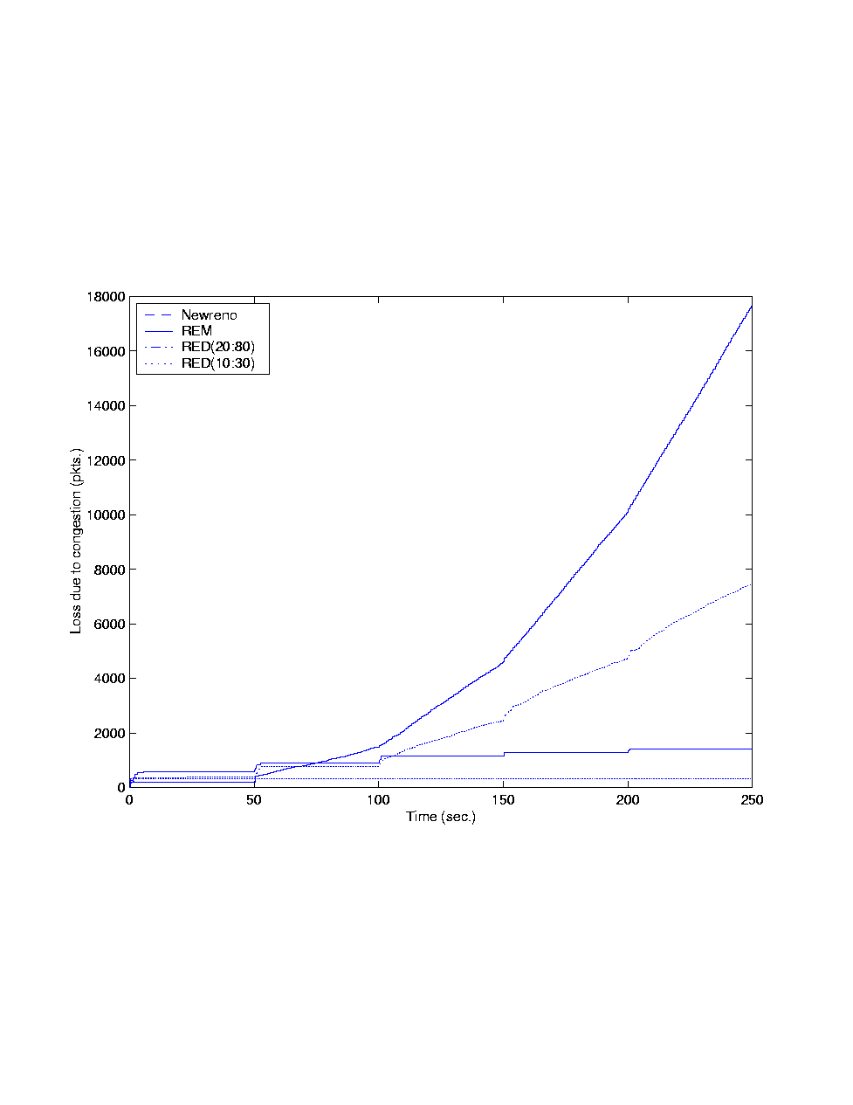
Performance
Goodput

Slide 75
Part II
Models

Slide 76
Congestion Control
Heavy tail ➔ Mice-elephants
Internet
Elephant
Mice
efficient & fair sharing
small delay
queueing + propagation
Congestion control
CDN

Slide 77
TCP
x_{i}(t)

Slide 78
TCP & AQM
p_{l}(t)
x_{i}(t)
Example congestion measure p_{l}(t)
  Loss (Reno)
  Queueing delay (Vegas)

Slide 79
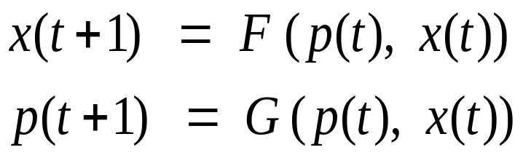
Outline
Protocol (Reno, Vegas, RED, REM/PI…)
Equilibrium
Performance
  Throughput, loss, delay
Fairness
Utility
Dynamics
Local stability
Cost of stabilization

Slide 80
TCP & AQM
p_{l}(t)
x_{i}(t)
Duality theory → equilibrium
Source rates x_{i}(t) are primal variables
Congestion measures p_{l}(t) are dual variables
Flow control is optimization process

Slide 81
TCP & AQM
p_{l}(t)
x_{i}(t)
Control theory → stability
Internet as a feedback system
Distributed & delayed

Slide 82
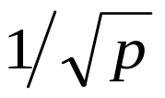
Outline
Introduction
Algorithms
  Window flow control
  TCP algorithm: Tahoe, Reno, Vegas
  AQM algorithm: RED, REM, variants
Models
  Duality model
  Linear dynamic model

Slide 83
Flow control
Interaction of source rates x_{s}(t) and congestion measures p_{l}(t)
Duality theory
  They are primal and dual variables
  Flow control is optimization process
Example congestion measure
  Loss (Reno)
  Queueing delay (Vegas)
Notes:
The idea of this talk is well captured by Richard Gibben’s talk yesterday where we can regard flow control as an interaction of source rates at the hosts and some kind of congestion measures in the network. Example congestion measures include packet loss in Reno, end to end queueing delay, without propagation delay,in Vegas, queue length in RED, and a quantity we call price in REM, a scheme which we will come back to later in the talk.
When source rates increase, this pushes up the congestion measures in the network, say, losses in Reno, which then in turn suppresses the source rates, and the cycle repeats. Duality theory then suggest that we interpret source rates as primal variables, the congestion measures as dual variables, and the flow control process that iterates on these variables as a primal-dual algorithm to maximize aggregate source utility.
The rest of the talk is to make this intuition a bit more precise.

Slide 84


Model
Sources s
  L(s) - links used by source s
  U_{s}(x_{s}) - utility if source rate = x_{s}
Network
  Links l of capacities c_{l}
x₁
c₁
c₂
x₂
x₃

Slide 85
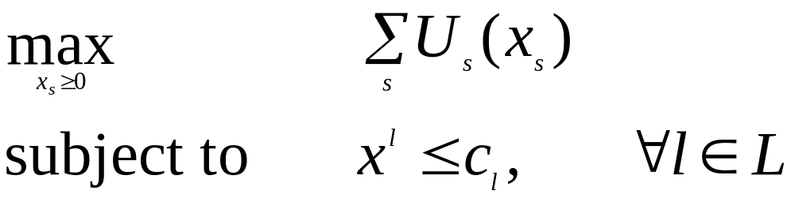
Primal problem
Assumptions
  Strictly concave increasing U_{s}
Unique optimal rates x_{s} exist
Direct solution impractical

Slide 86
History
Formulation
  Kelly 1997
Penalty function approach
  Kelly, Maulloo and Tan 1998
  Kunniyur and Srikant 2000
Duality approach
  Low and Lapsley 1999
  Athuraliya and Low 2000, Low 2000
Many extensions…

Slide 87
History
Formulation
  Kelly 1997
Penalty function approach
  Kelly, Maulloo and Tan 1998
  Kunniyur and Srikant 2000
Duality approach
  Low and Lapsley 1999
  Athuraliya and Low 2000, Low 2000
Many extensions…

Slide 88
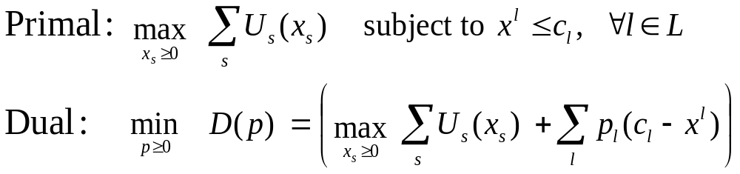
Duality Approach
Primal-dual algorithm:
Notes:
So we have the primal problem that maximizes aggregate utility subject to capacity constraints. Its dual problem is to minimize a certain function we call D(p). We call the vector p the congestion meausre and ….
The primal dual algorithm takes the following general form where the source rate vector x(t+1) in the next period is a certain function F of the current price vector p(t) and source rates x(t), and the price p(t+1) is a certain function G of the current prices and rates.

Slide 89
Duality Model of TCP/AQM
Source algorithm iterates on rates
Link algorithm iterates on prices
With different utility functions
Primal-dual algorithm:
Reno, Vegas
DropTail, RED, REM
Notes:
So the source algorithm is this F that iterates on prices and rates to produce a new rate, and the link algorithm is this G that iterates on prices and rates to produce a new price.
In TCP, F is carried out by Reno and Vegas, they are just different F’s. G is carried out by queue managements, active or inactive, such as DropTail, RED, or REM, they are just different G’s.
The different pairs (F, G) all try to solve the primal problem, but with different utility functions. That’s all.

Slide 90
Example
Basic algorithm
Theorem (ToN’99)
Converge to optimal rates in asynchronous
environment
TCP schemes are smoothed versions of source
algorithm …

Slide 91
Summary
Flow control problem
Primal-dual algorithm
Major TCP schemes
  Maximize aggregate source utility
  With different utility functions

Slide 92
Summary
What are the (F, G, U) ?
Derivation
  Derive (F, G) from protocol description
  Fix point (x, p) = (F, G) gives equilibrium
  Derive U
    regard fixed point as Kuhn-Tucker condition

Slide 93
Outline
Protocol (Reno, Vegas, RED, REM/PI…)
Equilibrium
Performance
  Throughput, loss, delay
Fairness
Utility
Dynamics
Local stability
Cost of stabilization

Slide 94
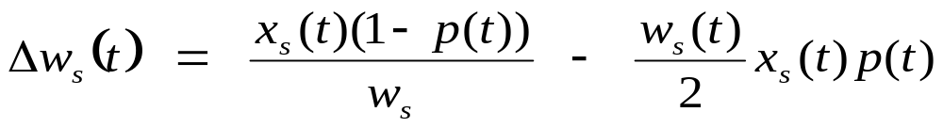
Reno: F
for every ack (ca)
{ W += 1/W }
for every loss
{ W := W/2 }
Primal-dual algorithm:
x(t+1) = F( p(t), x(t) )
p(t+1) = G( p(t), x(t) )
Reno, Vegas
DropTail, RED, REM

Slide 95
Reno: F
for every ack (ca)
{ W += 1/W }
for every loss
{ W := W/2 }
Primal-dual algorithm:
x(t+1) = F( p(t), x(t) )
p(t+1) = G( p(t), x(t) )
Reno, Vegas
DropTail, RED, REM

Slide 96
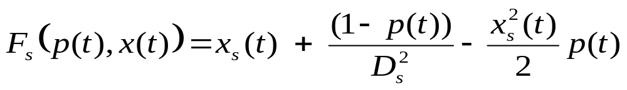
Reno: F
for every ack (ca)
{ W += 1/W }
for every loss
{ W := W/2 }
Primal-dual algorithm:
x(t+1) = F( p(t), x(t) )
p(t+1) = G( p(t), x(t) )
Reno, Vegas
DropTail, RED, REM

Slide 97
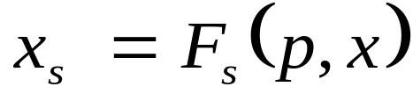
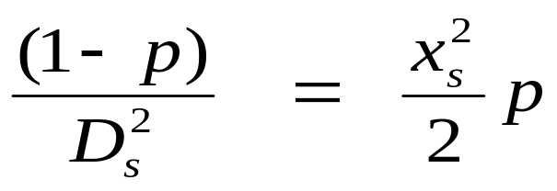
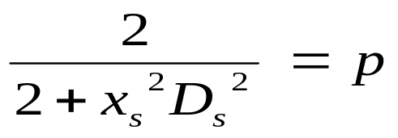
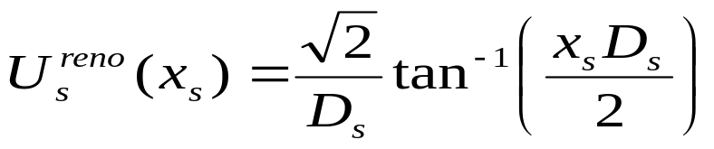
Reno: Utility Function

Slide 98
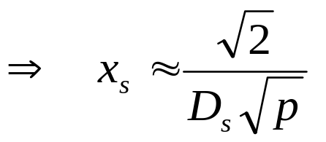
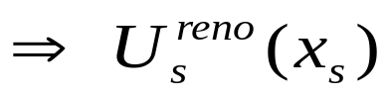
Reno: summary
Equilibrium characterization
Duality
Congestion measure p = loss
Implications
  Reno equalizes window w = D_{s}x_{s}
  inversely proportional to delay D_{s}
  dependence for small p
Notes:
The 3 implications of throughput have been widely observed in previous studies.
Note however that most previous models assume p is loss probability due to random (noncongestion) loss. Here p is solely determined by congestion.
If we think of the loss probability m under Reno (without marking) as a process that evolves with rate adjustments by the sources, then this process together with source rate process again can be thought of as a dual algorithm to solve the dual problem. It is however hard to determine the algorithm without understanding how loss is affected by the rate process (which is a difficult problem).

Slide 99
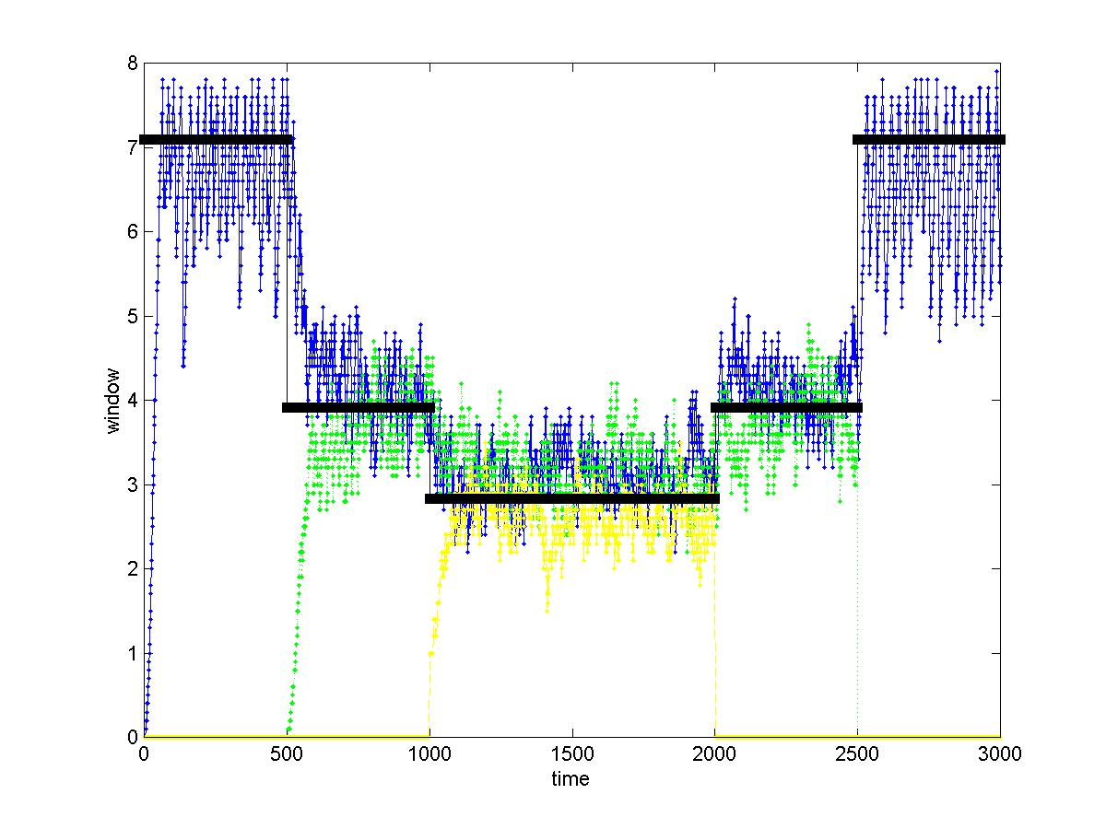
Validation - Reno
30 sources, 3 groups with RTT = 3, 5, 7ms + 6ms (queueing delay) Link capacity = 64 Mbps, buffer = 50 kB
Measured windows equalized, match well with theory (black line)
Notes:
3 groups of 10 sources each, with RTT (propagation delay + queueing, from measurement) 9, 11 & 13 ms.
Group 1 starts at time 0, group 2 starts at time 500, and group 3 starts at time 1000.
Graph shows the mean window process, averaged over the 10 sources of each group.
Window is in unit of packets, each of size 1kBytes.
Note
Windows are equalized, independent of RTTs
Measured windows match well with those predicted by the model
Note: Individual windows were halved on each decrement, but the graph shows the window process averaged over 10 sources in each group.

Slide 100
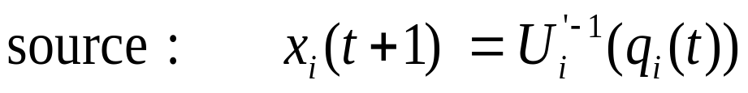
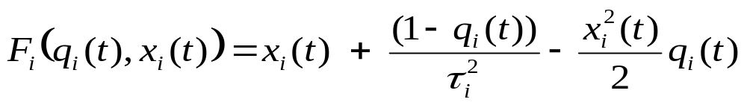
Reno & gradient algorithm
Gradient algorithm
TCP approximate version of gradient algorithm

Slide 101
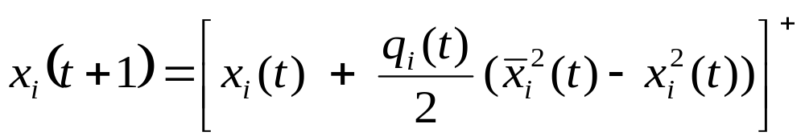
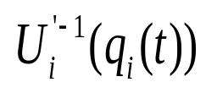
Reno & gradient algorithm
Gradient algorithm
TCP approximate version of gradient algorithm

Slide 102
Active Queue Management
p_{l}(t) G(p(t), x(t))
DropTail loss [1 - c_{l}/x^{l} (t)]⁺ (?)
DropTail delay [p_{l}(t) + x^{l} (t)/c_{l} - 1]⁺
RED queue [p_{l}(t) + x^{l}(t) - c_{l}]⁺
REM price [p_{l}(t) + γ(α_{l} b_{l}(t)+ x^{l} (t) - c_{l} )]⁺
x(t+1) = F( p(t), x(t) )
p(t+1) = G( p(t), x(t) )
Reno, Vegas
DropTail, RED, REM

Slide 103
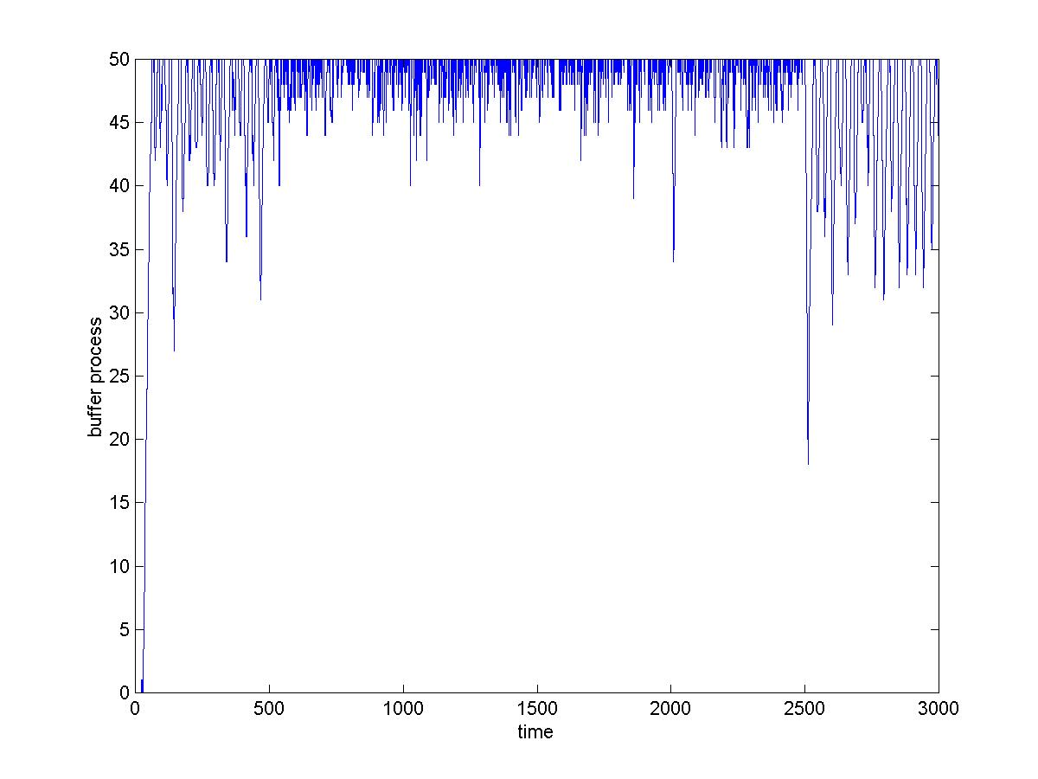
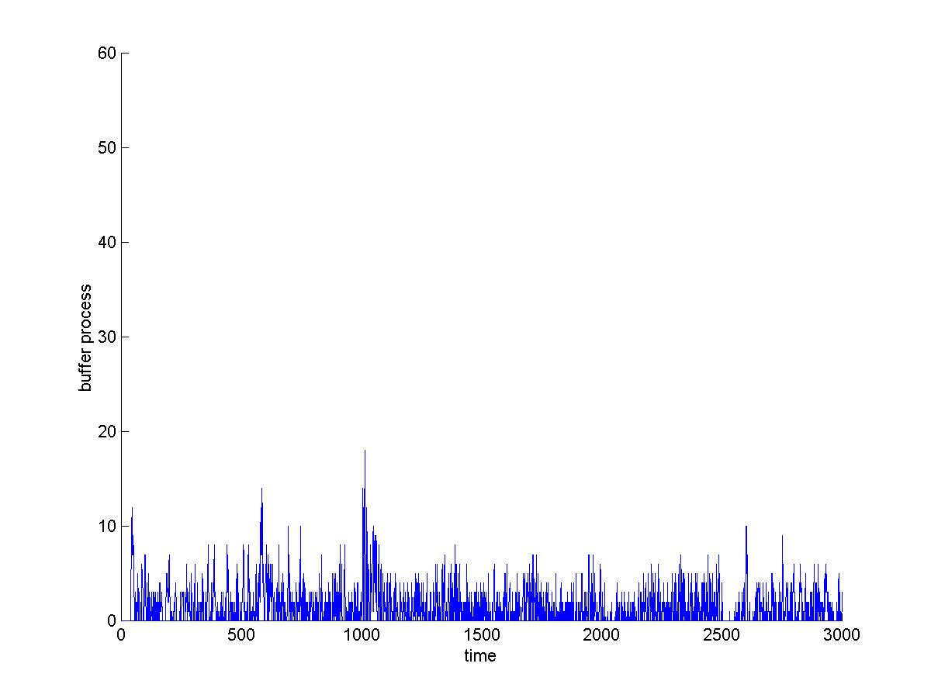
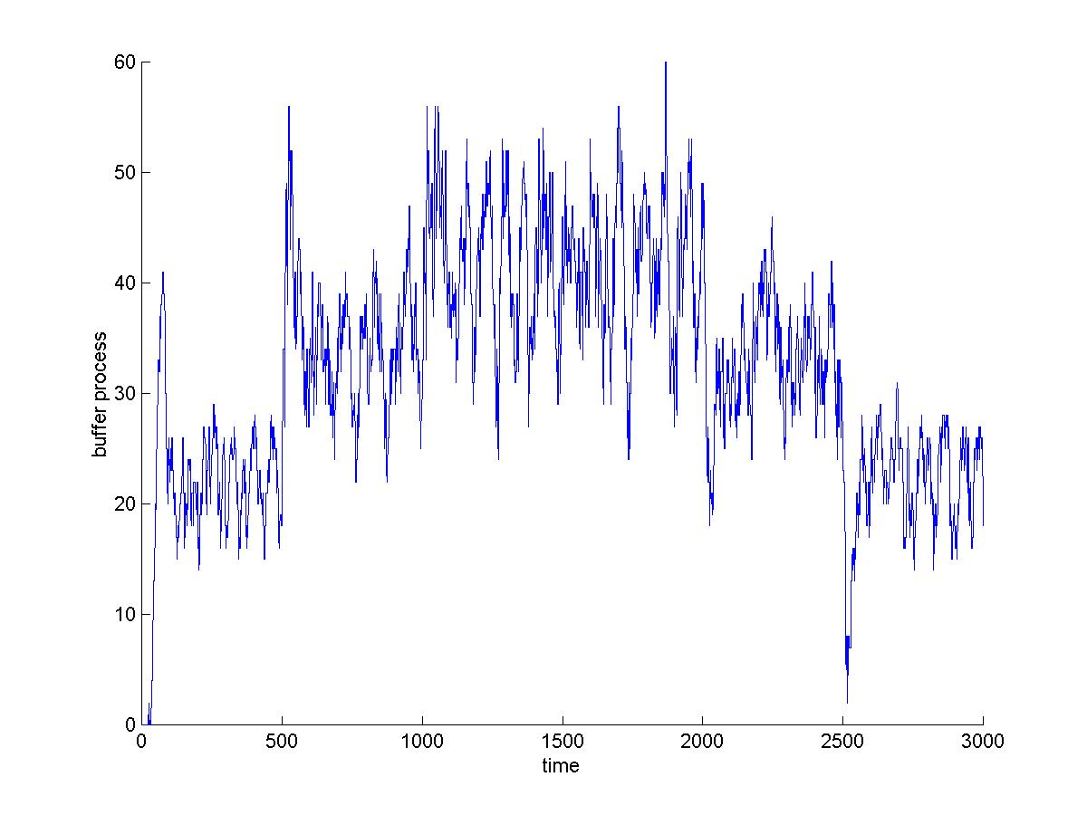
Queue
REM
queue = 1.5 pkts
utilization = 92%
γ = 0.05, α = 0.4, φ = 1.15
p = Lagrange multiplier!
DropTail
queue = 94%
p decoupled from queue
RED
min_th = 10 pkts
max_th = 40 pkts
max_p = 0.1
p increasing in queue!
Notes:
30 sources, 3 groups with RTT = 3, 5, 7ms + 6ms (queueing delay) Link capacity = 64 Mbps, buffer = 50 kB
3 groups of 10 sources each, with RTT (propagation delay + queueing, from measurement) 9, 11 & 13 ms.
Group 1 starts at time 0, group 2 starts at time 500, and group 3 starts at time 1000.
Graph shows the mean window process, averaged over the 10 sources of each group.
Window is in unit of packets, each of size 1kBytes.
Note
Windows are equalized, independent of RTTs
Measured windows match well with those predicted by the model
Note: Individual windows were halved on each decrement, but the graph shows the window process averaged over 10 sources in each group.

Slide 104
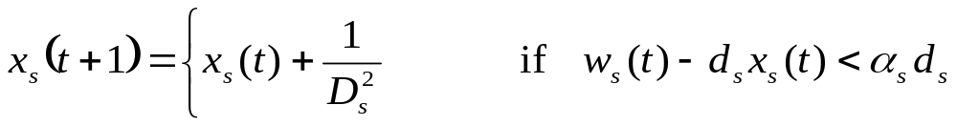
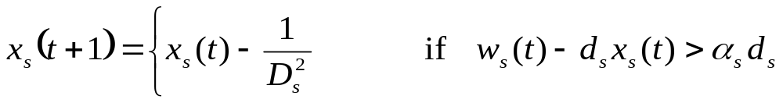

Vegas
for every RTT
{ if W/RTT_{min} – W/RTT < α then W ++
if W/RTT_{min} – W/RTT > α then W -- }
for every loss
W := W/2
queue size
F:
G:
p_{l}(t+1) = [p_{l}(t) + x^{l} (t)/c_{l} - 1]⁺

Slide 105
Implications
Performance
  Rate, delay, queue, loss
Interaction
  Fairness
  TCP-friendliness
Utility function

Slide 106
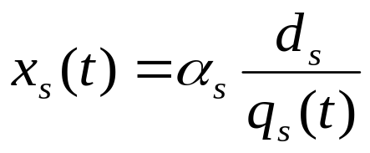
Performance
Delay
  Congestion measures: end to end queueing delay
  Sets rate
  Equilibrium condition: Little’s Law
Loss
  No loss if converge (with sufficient buffer)
  Otherwise: revert to Reno (loss unavoidable)

Slide 107
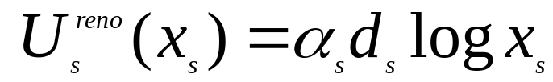
Vegas Utility
Equilibrium (x, p) = (F, G)
Proportional fairness

Slide 108
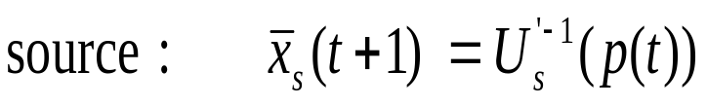
Vegas & Basic Algorithm
Basic algorithm
TCP smoothed version of Basic Algorithm …

Slide 109
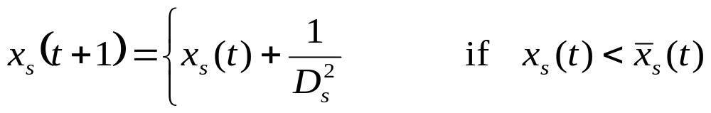
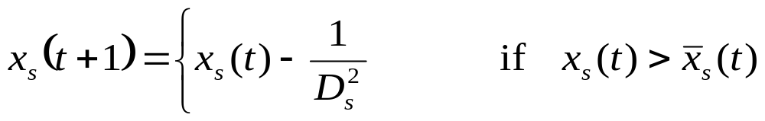
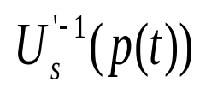
Vegas & Gradient Algorithm
Basic algorithm
TCP smoothed version of Basic Algorithm …
Vegas

Slide 110
Validation
Source 1 Source 3 Source 5
RTT (ms) 17.1 (17) 21.9 (22) 41.9 (42)
Rate (pkts/s) 1205 (1200) 1228 (1200) 1161 (1200)
Window (pkts) 20.5 (20.4) 27 (26.4) 49.8 (50.4)
Avg backlog (pkts) 9.8 (10)
meausred
theory
Single link, capacity = 6 pkts/ms
5 sources with different propagation delays, α_{s} = 2 pkts/RTT

Slide 111
Persistent congestion
Vegas exploits buffer process to compute prices (queueing delays)
Persistent congestion due to
  Coupling of buffer & price
  Error in propagation delay estimation
Consequences
  Excessive backlog
  Unfairness to older sources
Theorem
A relative error of ε_{s} in propagation delay estimation distorts the utility function to

Slide 112
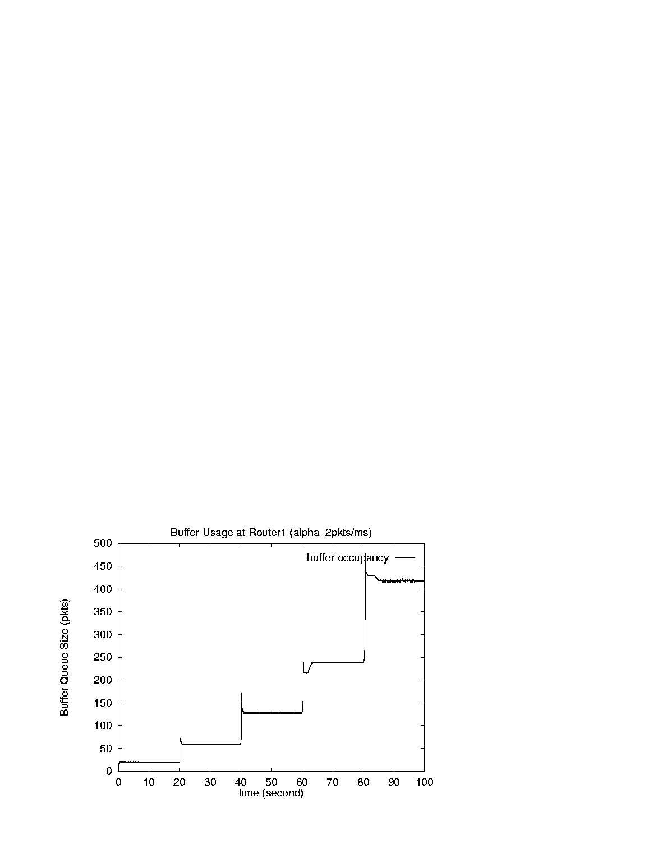
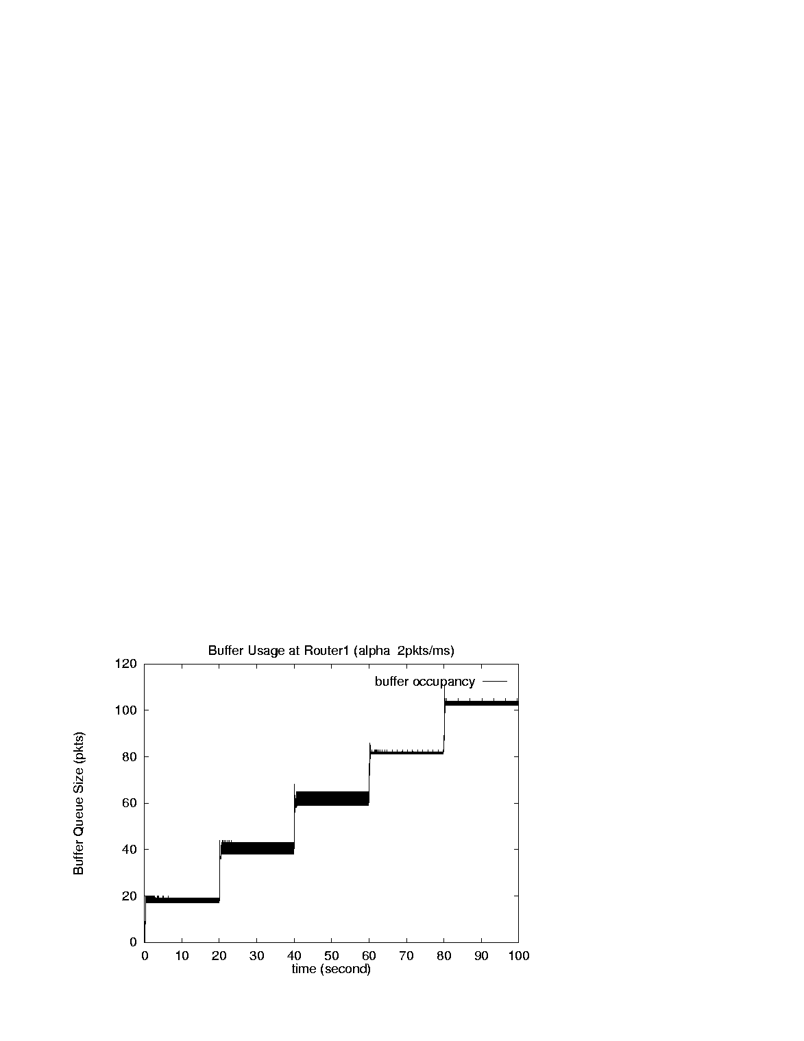
Evidence
Without estimation error
With estimation error
Single link, capacity = 6 pkt/ms, α_{s} = 2 pkts/ms, d_{s} = 10 ms
With finite buffer: Vegas reverts to Reno

Slide 113
Evidence
Source rates (pkts/ms)
# src1 src2 src3 src4 src5
5.98 (6)
2.05 (2) 3.92 (4)
0.96 (0.94) 1.46 (1.49) 3.54 (3.57)
0.51 (0.50) 0.72 (0.73) 1.34 (1.35) 3.38 (3.39)
0.29 (0.29) 0.40 (0.40) 0.68 (0.67) 1.30 (1.30) 3.28 (3.34)
# queue (pkts) baseRTT (ms)
19.8 (20) 10.18 (10.18)
59.0 (60) 13.36 (13.51)
127.3 (127) 20.17 (20.28)
237.5 (238) 31.50 (31.50)
416.3 (416) 49.86 (49.80)

Slide 114
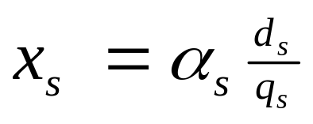

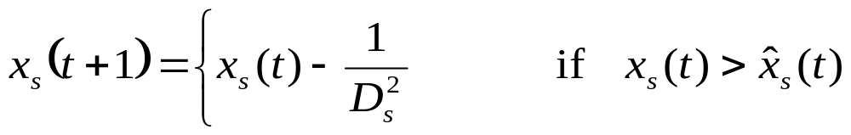
Vegas/REM
To preserve Vegas utility function & rates
REM
  Clear buffer : estimate of d_{s}
  Sum prices : estimate of p^{s}
Vegas/REM
end2end queueing delay

Slide 115
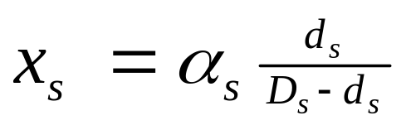
Vegas/REM
To preserve Vegas utility function & rates
REM
  Clear buffer : estimate of d_{s}
  Sum prices : estimate of p^{s}
Vegas/REM
end2end queueing delay

Slide 116
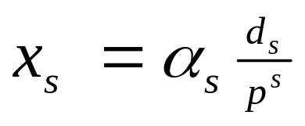
Vegas/REM
To preserve Vegas utility function & rates
REM
  Clear buffer : estimate of d_{s}
  Sum prices : estimate of p^{s}
Vegas/REM
end2end price

Slide 117
Vegas/REM
To preserve Vegas utility function & rates
REM
  Clear buffer : estimate of d_{s}
  Sum prices : estimate of p^{s}
Vegas/REM
end2end price

Slide 118
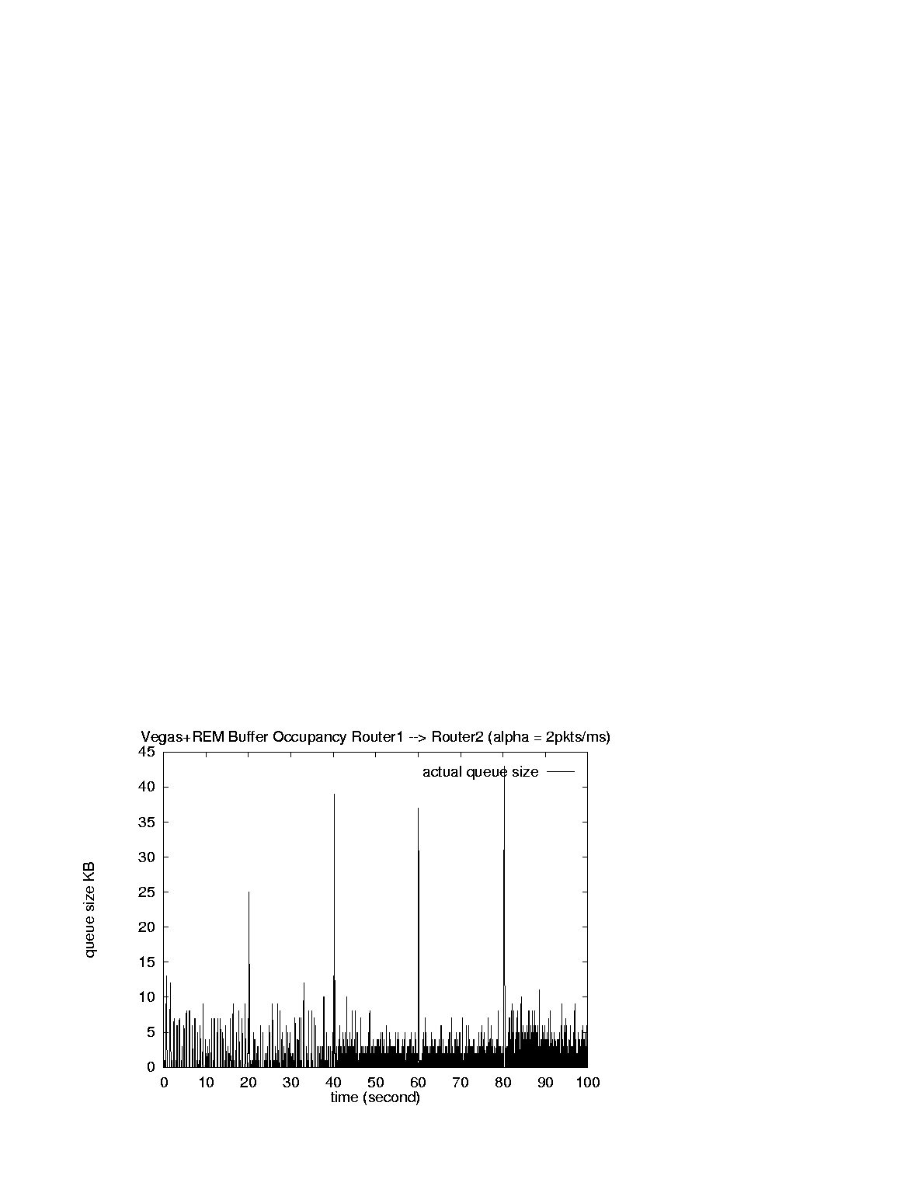
Performance
peak = 43 pkts
utilization : 90% - 96%
Vegas/REM
Vegas

Slide 119
Conclusion
Duality model of TCP: (F, G, U)
Reno, Vegas
Maximize aggregate utility
With different utility functions
DropTail, RED, REM
Decouple congestion & performance
Match rate, clear buffer
Sum prices

Slide 120
Outline
Protocol (Reno, Vegas, RED, REM/PI…)
Equilibrium
Performance
  Throughput, loss, delay
Fairness
Utility
Dynamics
Local stability
Cost of stabilization

Slide 121
Model structure
Multi-link multi-source network
R_{f}(s)
F₁
G₁
F_{N}
G_{L}
R_{b}’(s)
TCP
Network
AQM

Slide 122
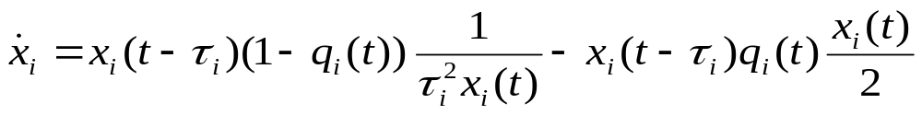
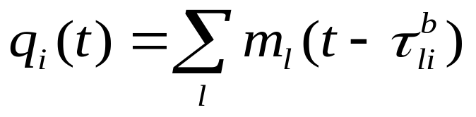
Duality model - AIMD
AI
MD
source rate
e2e prob

Slide 123

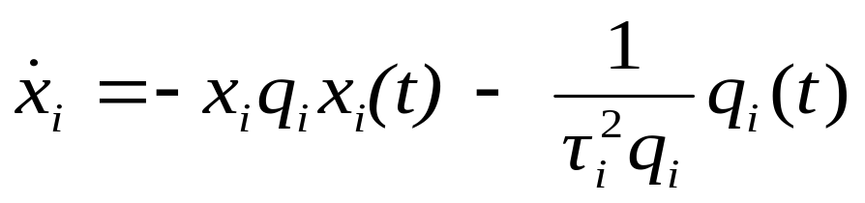
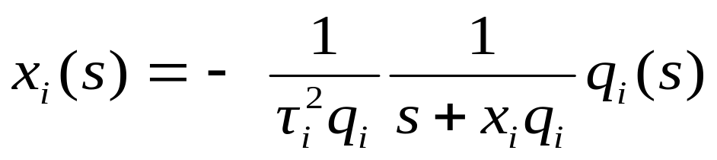
Linear model - AIMD
AI
MD
Linearize around equilibrium
In Laplace domain

Slide 124
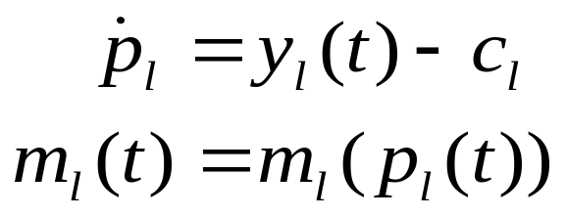
Duality model - AIMD
congestion
measure
marking
prob

Slide 125



Linear model - AIMD
Aggregate rate
Linearize around equilibrium
In Laplace domain

Slide 126

Linear Model - Network
Multi-link multi-source model
x
R_{f}(s)
y
F₁
G₁
F_{N}
G_{L}
q
p
R_{b}^{T}(s)
TCP
Network
AQM
Closed loop system is stable if and only if
det (I + L(s)) = 0
for no s in closed RHP

Slide 127

Linearized system
x
y
R_{f}(s)
F₁
G₁
F_{N}
G_{L}
q
p
R_{b}’(s)
TCP
RED
queue
delay

Slide 128
Papers
netlab.caltech.edu
Scalable laws for stable network congestion control (CDC2001)
A duality model of TCP flow controls (ITC, Sept 2000)
Optimization flow control, I: basic algorithm & convergence (ToN, 7(6), Dec 1999)
Understanding Vegas: a duality model (J. ACM, 2002)
REM: active queue management (Network, May/June 2001)

